Slide 1
Growing your investment
Tools & techniques to cultivate a quality item bank
Julie Miles, PhD
Vice President, Global Testing Services

Slide 2
Topics we will cover
Step 2: Growing
Step 3: Harvesting
Using Innovation to Generate Items
Item quality
Step 1: Cultivating
CONSTRUCT DEFINITION

Slide 3
Construct definition
Construct, n. /kɒnstrʌkt/
“the concept or characteristic that a test is designed to measure”
~The Standards for Educational and Psychological Testing ,
AERA, APA, & NCME, 2014

Slide 4
What
is the PURPOSE of the test?
HOW should it be tested?
WHAT should be tested?

Slide 5
WHAT should be tested?
A test is always a sample from the content domain.
X
X

Slide 6
WHAT should be tested?
Determining constructs for tests related to professional competency
If the purpose is to make inferences about the test-taker’s knowledge or competence
Start with a well-defined content domain
By
defining the body of knowledge
identifying the knowledge, skills, and abilities that are required for minimal competence
Notes:
Let’s take a look in more detail about how test specifications are created for professional tests (i.e., those that assess minimal competence related to a profession).

Slide 7
Fleshing out construct definitions
The user story technique
In my role as a nursing assistant transferring patients, I use proper lifting techniques in order to protect the patient and myself from injury.
In my role as a financial advisor, I evaluate alternatives for raising capital in order to advise on the best way to meet my client’s financial goals.
As a cosmetologist performing a hair color retouch, I avoid overlapping color onto previously colored hair in order to prevent a line of demarcation.
ROLE
ACTION
GOAL
Source: Becker, K.A. & Brunner, B. (March 2014). Enhancing your test plan and building better items. Paper presented at the annual conference of the Association of Test Publishers, Scottsdale, AZ.
Notes:
The tasks performed by professionals are typically complex, and many times the test constructs are implicitly implied in the test blueprint rather than explicitly being spelled out. For instance, “being a leader” or “being an excellent communicator” probably wouldn’t be explicitly stated on a test blueprint but implied in the tasks that a professional might perform. Also, some professionals have different levels, a registered nurse and an enrolled nurse, and there may be differences in interpretation of what constitutes the ceiling of one level vs another.
One of the techniques we used at Pearson VUE to work with SMEs to tease out the test blueprint in greater detail as a first step to designing test items to meet the construct demands is the user story technique borrowed from Agile product management methodology. User story – define requirements.
Examples from various professionals. ASPPB, CITB, CIMA….
Benefits…

Slide 8
Benefits of Construct Definition
Refine the construct map
Create common understanding of construct requirements
Specify context in which tasks are performed
Clarify role delineation across different qualification levels

Slide 9
Determining what should be tested is the first step in creating the recipe for the test..

Slide 10
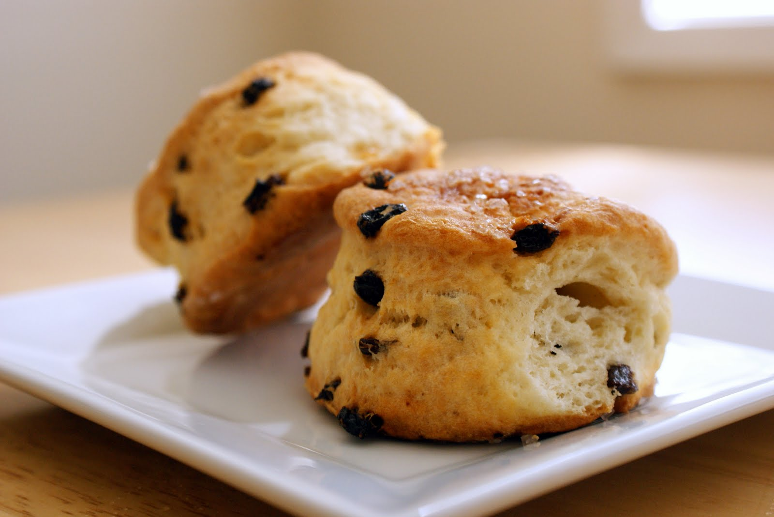
Scones
What
Ingredients
25g/8oz self raising flour
pinch of salt
55g/2oz butter
25g/1oz caster sugar
150ml/5fl oz milk
1 free-range egg, beaten, to glaze
Preparation method
Heat the oven to 220C/425F/Gas 7. Lightly grease a baking sheet.
Mix together the flour and salt and rub in the butter.
Stir in the sugar and then the milk to get a soft dough.
Turn on to a floured work surface and knead very lightly. Pat out to a round 2cm/¾in thick. Use a 5cm/2in cutter to stamp out rounds and place on a baking sheet. Lightly knead together the rest of the dough and stamp out more scones to use it all up.
Brush the tops of the scones with the beaten egg. Bake for 12-15 minutes until well risen and golden.
How
Notes:
Test specifications are like a recipe – they provide the ingredients (what is being assessed); how many/much of each ingredient (the distribution of the test items and the total number) and how (the particular specifications) those things are mixed together to create a test.

Slide 11
Test specifications
WHAT
Test blueprint
Operational definition of the test construct
Content or performance areas
Number of items in each area
Type of items (possibly)
Test plan
A detailed, written plan for a test
Descriptions of the test’s purpose and target audience
Scoring methodology
Test administration method
Desired psychometric characteristics of the items and the test
HOW
Notes:
One of the first ways to insure you are focused on the intended competencies is to clearly define your exam with a test specifications document. There are two components of the test specifications. [space bar] The first part is a test blueprint which includes very specific information on the exam itself which can be considered to be the operational definition of the test construct. [space bar] The second part is the test plan which is a detailed description of the test’s purpose and target audience along with how the test will be administered and scored along with the desired psychometric characteristics of the exam (e.g., how easy, how hard, etc). Either or both of these documents may be provided to test takers as a communication tool on what to expect on the exam. So the test blueprint is the [space bar] WHAT and the test plan is the [space bar] HOW. NEXT SLIDE

Slide 12
HOW should it be tested?
Determining item types – considerations
Type of assessment – summative vs formative
Characteristics of the test-taker population
Political environment/stakeholders
Available resources
Time allotted for exam
Mode of testing
Importance of immediate scoring
Notes:
Summative vs formative – some item types may be more suited to classroom formative assessments. For instance, essays or other writing samples can be more cumbersome and impractical for very large scale assessments.
Test taker characteristics – reading level, language skills, computer literacy etc.
Political environment – perceptions of stakeholders (candidates, learning providers/educators, employers). Let’s face it, some stakeholders do perceive MCQs as ‘dummying down the test’ or not desirable for other reasons, such as because test takers can guess the right answer. The first article that was provided on the first slide from CQU was an example of stakeholder perceptions influencing item type selection.
Resources – different item types may require different resources and resources available at different times. For instance, essays may be easier to write than good multiple choice items but there is a greater resource investment in creating the scoring rubrics and in human marking.
Time allotted for the test – MCQs are very efficient, can answer several MCQs in the time taken to respond to an essay.
Mode of testing & importance of immediate scoring – One of the advantages of CBT is the ability to release scores immediately. If constructed response items require human marking this advantage can’t be realized.

Slide 13
Determining item types – considerations
Validity
Construct underrepresentation
Construct irrelevant variance
Reliability
Number of questions
Inter-rater reliability
Fairness
Subgroup differences
Notes:
All of the issues discussed on the previous slides are certainly factors to consider when selecting item types, but the most important consideration is making sure your test is valid, fair and reliable.
With regard to validity, the test needs to do a good job of representing your construct. One of the concerns here is construct underrepresentation, meaning that you haven’t assessed all of the knowledge, skills and abilities that comprise the test construct and needed to be assessed to meet the purpose of the test. Construct irrelevant variance is also a concern. This means that that the test results are influenced by factors that are not part of the desired test construct. For example, reading or writing ability affecting test scores when reading or writing ability is not what is meant to be measured.
Reliability is affected by the number of test questions. This is a consideration in selecting item types because some types of items take longer to respond to than others. With items that are human marked, inter-rater agreement is also a concern. Fairness concerns subgroup differences. Test takers with similar ability should receive similar scores regardless of what subgroup they are included in. Examples of subgroups, gender, race, ethnicity. With regard to item selection, you don’t want the item type to disadvantage a subgroup.

Slide 14
Using innovation to generate items
Notes:
Son once you’ve determined which item types you want, how can you use innovation to build an item bank?

Slide 15
The premise:
Traditional item development methods are craft projects.
The opportunity:
How can we get a bigger ‘bang for our buck’ in item development?
From craft projects
To production processes

Slide 16
Ways to be more productive
Automated item generation
Manual modelling methods
Creativity tools

Slide 17
Automated item generation
Key concepts
Each item model is composed of a series of elements.
Incidental elements – Those elements that can be manipulated without expecting to change the item’s psychometric characteristics.
Radical elements – Those elements for which manipulation is expected to change the item’s psychometric characteristics.
David plans to borrow $5,000 for home improvement. The bank offers a five-year loan with a 3.75% annual simple interest rate. How much will he repay in total by the end of the five-year loan?

Slide 18
Automated item generation
Key concepts
New items produced from the item model which have similar psychometric characteristics are called isomorphs.

Slide 19
Automated item generation
Key concepts
New items produced from the item model which have different psychometric characteristics are called variants.

Slide 20
Automated item generation
Key concepts
AIG in its most sophisticated form will be able to generate statistically calibrated items using item models and computer technology. (Gierl & Haladyna, 2013)
Step 1: Identify and control item elements which affect item difficulty in an item model.
Step 2: Use computer technology to generate many, many new items from the item model.
If step 1 is successful, new items will not need to be pre-tested as their psychometric properties are estimated from statistical models.

Slide 21
Automated item generation
Key concepts
Weak vs strong theory (Drasgow, Luecht, & Bennett, 2006)
Weak theory: The elements that do and do not affect item difficulty are differentiated through the judgment and experiences of Subject Matter Experts.
Strong theory: A cognitive model and design principles are used to predict the psychometric principles of generated item models.

Slide 22
Electronic item modelling
Using AIG to create isomorphs from weak theory
Generating multiple item variants by automatically producing alternatives for pre-defined item elements using pre-defined parameters
Parent item:
Tom has (two) blue marbles and (two) red marbles. How many total marbles does Tom have?
Parameters
Between 1 and 5
Between 1 and 5
Result is >2 and <10
Integer < 0 & >10

Slide 23
Electronic item modelling
Criticisms
Assumptions about what may alter item difficulty may be faulty
Items appear too similar to one another because the number of manipulations is typically small
Easy to detect by coaches and test preparation companies
Simplistic product from an overly simple item production process

Slide 24
Manual item modelling
Accounting example – Generating a grammatically correct item
Source: Brunner, B. (2017). Item writing: Methods for gaining a greater return on investment. CLEAR Exam Review, 26(2), 16-22.

Slide 25
Manual item modelling
Logical reasoning example – Parent Item
Five ships [Element 1] arrived in port [Element 2] on five consecutive days [Element 3], Monday through Friday [Element 3a-e]. The five ships are the Independence [Element 1a], the Endurance [Element 1b], the Catalyst [Element 1c], the Prosperity [Element 1d], and the Stalwart [Element 1e].
The Prosperity [Element 1d] was the last to come into port [Element 2].
The Stalwart [Element 1e] arrive in port [Element 2] two days [Element 3] before the Catalyst [Element 1c].
The Endurance [Element 1b] arrived in port [Element 2] on Tuesday [Element 3d].
What day [Element 3] did the Independence [Element 1a] arrive?
Source: Brunner, B. (2017). Item writing: Methods for gaining a greater return on investment. CLEAR Exam Review, 26(2), 16-22.

Slide 26
Manual item modelling
Element Matrix
 | Elements
Element Definition | Object or item | Named object 1 | Named object 2 | Named object 3 | Named object 4 | Named object 5 | Collec-tion | Time frame | Time 1 | Time 2 | Time 3 | Time 4 | Time 5
 | 1 | 1a | 1b | 1c | 1d | 1e | 2 | 3 | 3a | 3b | 3c | 3d | 3e
Original | Ships | Indepen-dence | Endurance | Catalyst | Prosperity | Stalwart | Port | Days | Monday | Tuesday | Wednesday | Thursday | Friday
Variant1 | Planes | Chicago | Philadelphia | New York | Los Angeles | Houston | Airport | 15 min | 10:00 am | 10:15 am | 10:30 am | 10:45 am | 11:00 am
Variant2 | Classes | Art | Science | Geo-graphy | History | Music | Time slots | Sessions | 1st session | 2nd session | 3rd session | 4th session | 5th session
Variant3 | Books | To Kill a Mocking-bird | The Old Man and the Sea | Ulysses | Pride and Prejudice | Doctor Zhivago | Book club choices | Club meetings | January | February | March | April | May

Slide 27
Manual item modelling
Item Variant 1 (requires editing for grammar)
Planes from five destinations arrived at an airport in 15-minute intervals. The planes were travelling from Chicago, Philadelphia, New York, Los Angeles, and Houston. The first plane arrived at 10:00 in the morning.
The plane from Los Angeles was the last to arrive.
The Houston plane arrived at the airport 30 minutes before the one to New York.
The plane from Philadelphia arrived at 10:15.
What time did the plane from Chicago arrive at the airport?

Slide 28
Manual item modelling
Item Variant 2 (requires editing for grammar)
Classes held in consecutive time slots at a particular school were Art, Science, Geography, History, and Music. They were not held in that order.
History was the last class of the day.
Music was held two sessions before Geography.
Science was the second class of the day.
In what class session was Art held?

Slide 29
Manual item modelling
Item Variant 3 (requires editing for grammar)
A book club holds monthly club meetings. A different book is discussed each month. For the first five months of a particular year, the books discussed were To Kill a Mockingbird, The Old Man and the Sea, Ulysses, Pride and Prejudice, and Doctor Zhivago, but not in that order.
Pride and Prejudice was the last of the five books discussed.
Doctor Zhivago was discussed two club meetings before Ulysses.
The Old Man and the Sea was discussed at the February meeting.
In what month was To Kill a Mockingbird discussed?

Slide 30
Content Suitable for Modelling?
More Suitable | Less Suitable
Options are ‘symmetrical’ – same structure and type of option (e.g. 3 forms of investment risk, 3 forms of financial statement) | Options asymmetrical – items of different grammatical structure and type.
Options drawn from the same area of the curriculum | Options drawn from across the curriculum.
Where the concept tested has numerous characteristics (e.g. the business cycle; or features of a particular investment vehicle). | Single issue concepts (e.g. reasons for certain forms of regulation)
Items that focus on synthesis. These often require comparing and contrasting, which gives opportunities for many related characteristics to be used for options. (e.g. economic impact on inflation vs growth vs exports) | Definitional items where the options are describing the item named in the stem. There is too much individual ‘word-smithing’ in these items to create plausible but incorrect options for the item to be easily cloned.
Mirror image items. Certain concepts have an opposite concept with reversed characteristics making the item easier to ‘flip’ (e.g. Long and Short options; passive vs active portfolio management, inflows vs outflows, internal vs external documentation) | Items with ‘most likely’ in the stem or where the item is asking for the ‘best’ option. These options may require nuanced judgment that is harder to replicate and swap out with new options.
If at least one of the options is one of a number of close alternatives (e.g. components of a financial statement) | Items with lengthy, descriptive, wordy options.
Matrix options. Where each option has multiple variables that can be turned into a table or matrix making it possible to swap plausible options in and out. | Items based on vaguer, less concrete, attitudinal content (e.g. ethics, role of the investment industry, importance of documentation).
The stem is describing a process or series of steps. If ordering is relevant and testable (e.g. the business cycle or certain investment operations processes) this gives many opportunities to re-order and create plausible distractors.
Stem and/or options include moving variables. E.g. Increase/decrease (e.g. risk/revenue), Narrow/widen (e.g. spread).Positions on a chart curve and shape of the curve
Correlations - allowing a matrix of both correlation strength and direction.

Slide 31
Using Creativity Tools in Item Generation

Slide 32
Creativity tools
Why use?
Item writing ‘ideas’ challenges
SMEs are expert at the science of item writing, but not the art.
Some content areas difficult to write items for.
Item writers sometimes experience ‘writer’s block’.
It can be difficult to come up with with plausible distractors for multiple-choice items.

Slide 33
The SCAMPER technique
An example of a creativity tool
Substituting something
Combining it with something else
Adapting it to something else
Modifying or Magnifying it
Putting it to another use
Eliminating something
Reversing or Rearranging something
Notes:
Substituted – use larger plastic paper clips
Combined – Linking multiple paper clips together to make a piece of jewelry
Adapting – changing it’s shape to hold Christmas ornaments
Modifying – sharpening one end to make it a lapel pin
Another use – opening a lock
Eliminating something – straightening out the bends to make it longer
Reversing/Rearranging -

Slide 34
Using SCAMPER to build new items
Source: Brunner, B. (2017). Item writing: Methods for gaining a greater return on investment. CLEAR Exam Review, 26(2), 16-22.
Notes:
Take a content area from a test blueprint
Select a specific topic within the content area
Build multiple items from a single original good idea

Slide 35
Summary

Slide 36
Recap
Validity of the exam is based on cultivating a strong construct definition
Job Task Analysis
Blueprint
Item Development
Using Innovation to grow an item bank
Automated item generation
Manual modelling techniques
Creativity tools (e.g., SCAMPER)
Tools and techniques to cultivate a quality item bank

Slide 37
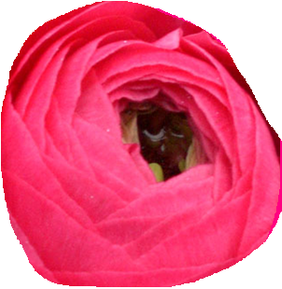
Final Thoughts
Just like plants need good soil, items require a well-defined construct upon which they can be developed.
For most current exam programs, true AIG is not feasible. However, its principles and other techniques can be used to grow item banks.
Larger item banks are only as good as the quality of the items. We want flowers, not weeds.

Slide 38
Thank You!

Slide 39
Item quality – DELETE (transition to AMY here)

Slide 40
General Item Writing Checklist
Has the learning outcome/ability to be measured been clearly stated?
Is this the most appropriate item type to assess the intended learning outcome/ability?
Have clear instructions been provided to the candidate?
Have external factors which might affect the candidate ability to answer the item been addressed?
Have scoring guidelines been clearly developed to eliminate bias or scoring inconsistencies?
Has the item been reviewed after it’s been written?
Source: Miller, M.D., Linn, R.L., & Gronlund, N.E. (2009) Measurement and Assessment in Teaching (10th Ed.). Upper Saddle River, NJ: Pearson Education, Inc.

Slide 41
Common Item Writing Pitfalls
Ambiguous statements
Excessive wordiness
Difficult vocabulary
Complex sentence structure
Unclear instructions
Unclear supporting materials
Item bias
Source: Miller, M.D., Linn, R.L., & Gronlund, N.E. (2009) Measurement and Assessment in Teaching (10th Ed.). Upper Saddle River, NJ: Pearson Education, Inc., p. 163.

Slide 42
Repairing items
Example 1
Original
The Amazon River is located:
A. on the North American continent
B. on the European continent
C. on the South America continent
D. on the border between Peru and Brazil
Improved
Where is the Amazon River located?
A. Africa
B. Europe
C. North America
D. South America

Slide 43
Repairing items
Example 2
Original
A tourist will NOT be able to see the Northern Lights in Alaska, EXCEPT when traveling in:
A. August
B. June
C. January
D. April
Improved
In Alaska, the Northern Lights are visible during:
A. April
B. August
C. June
D. January

Slide 44
Repairing items
Example 3
Original
A French drain is:
A. most often associated with a building foundation.
B. most often associated with an area drainage system.
C. most often associated with a hydromassage tub.
D. most often associated with a Mansard style roof.
Improved
A French drain is most often associated with a(n):
A. hydromassage tub.
B. area drainage system.
C. building foundation.
D. Mansard style roof.

Slide 45
Repairing items
Example 4
Original
Where is the Liberty Bell located?
A. Washington D.C.
B. Pennsylvania
C. Rhode Island
D. London
Improved
Where is The Liberty Bell located?
A. Washington D.C.
B. Pennsylvania
C. Rhode Island
D. Maryland

Slide 46
Characteristics of Good Items
Good items are:
Clear
Concise
Relevant
Grammatically correct
Stylistically consistent
Good items contain:
Plausible distractors
One correct answer
A source reference

